Slide 1
Computers in Amateur radio
Mike Walters
W8zy
Region 5 district emergency coordinator
Amateur radio emergency service
Northville Amateur Radio Association

Slide 2
Computers in amateur radio
For over 100 years amateur radio has been at the forefront of communication technology. Many of the greatest innovations came from hams. With the advent of the personal computer it was only natural for hams to incorporate computers into their experimentation and operations.

Slide 3
Computers in Amateur Radio
Logging
Programming and Operation
Digital Communication
Software Defined Radio

Slide 4
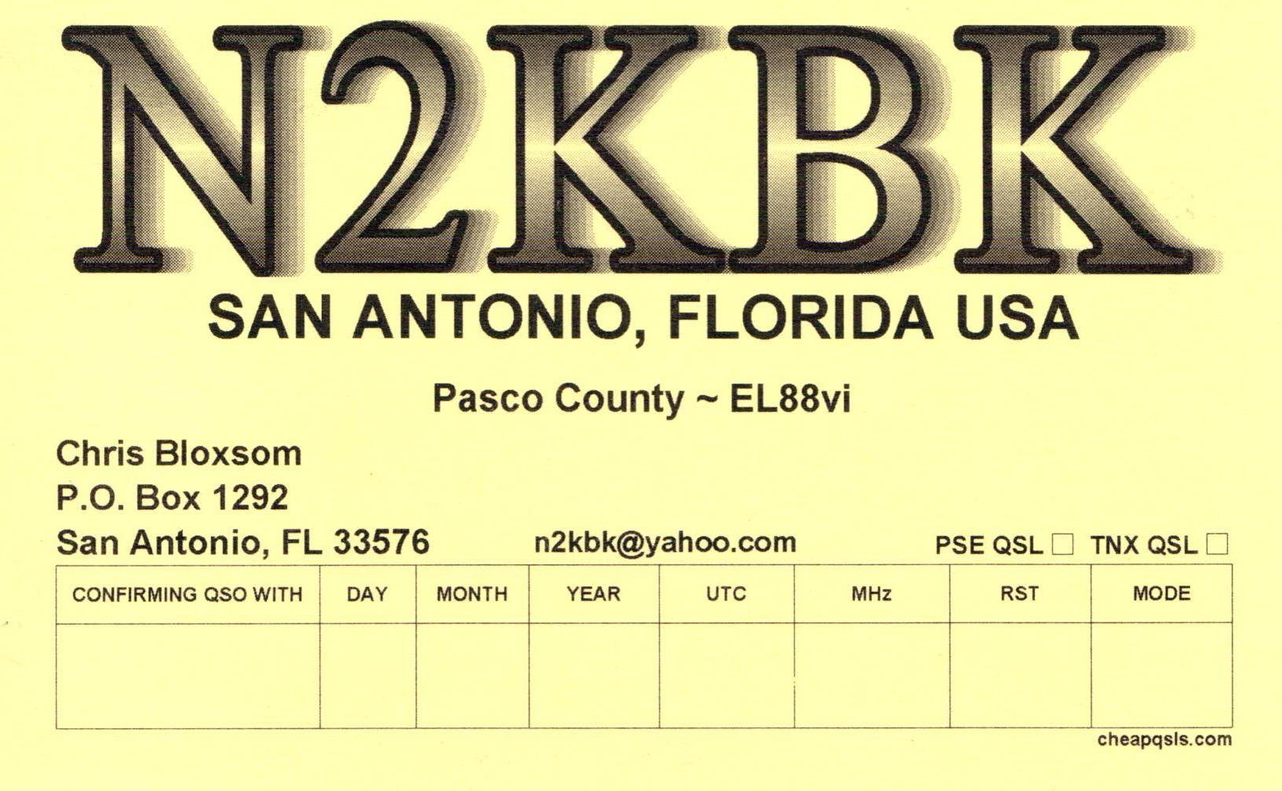
Logging

Slide 5
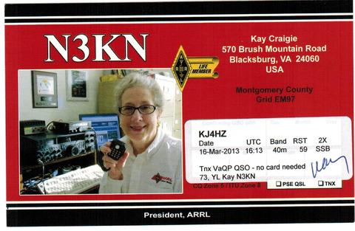

Slide 6
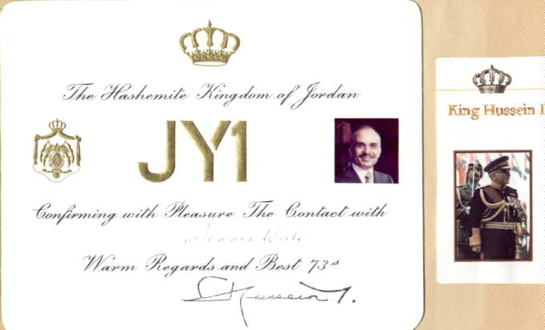

Slide 7
Logging Today

Slide 8
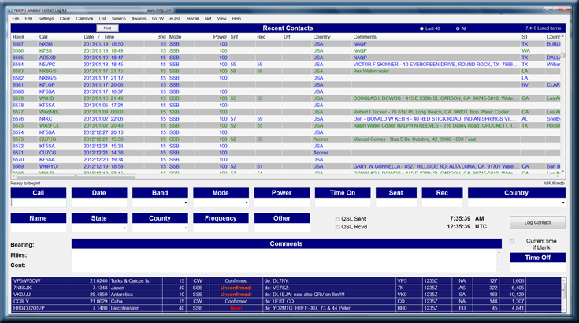

Slide 9
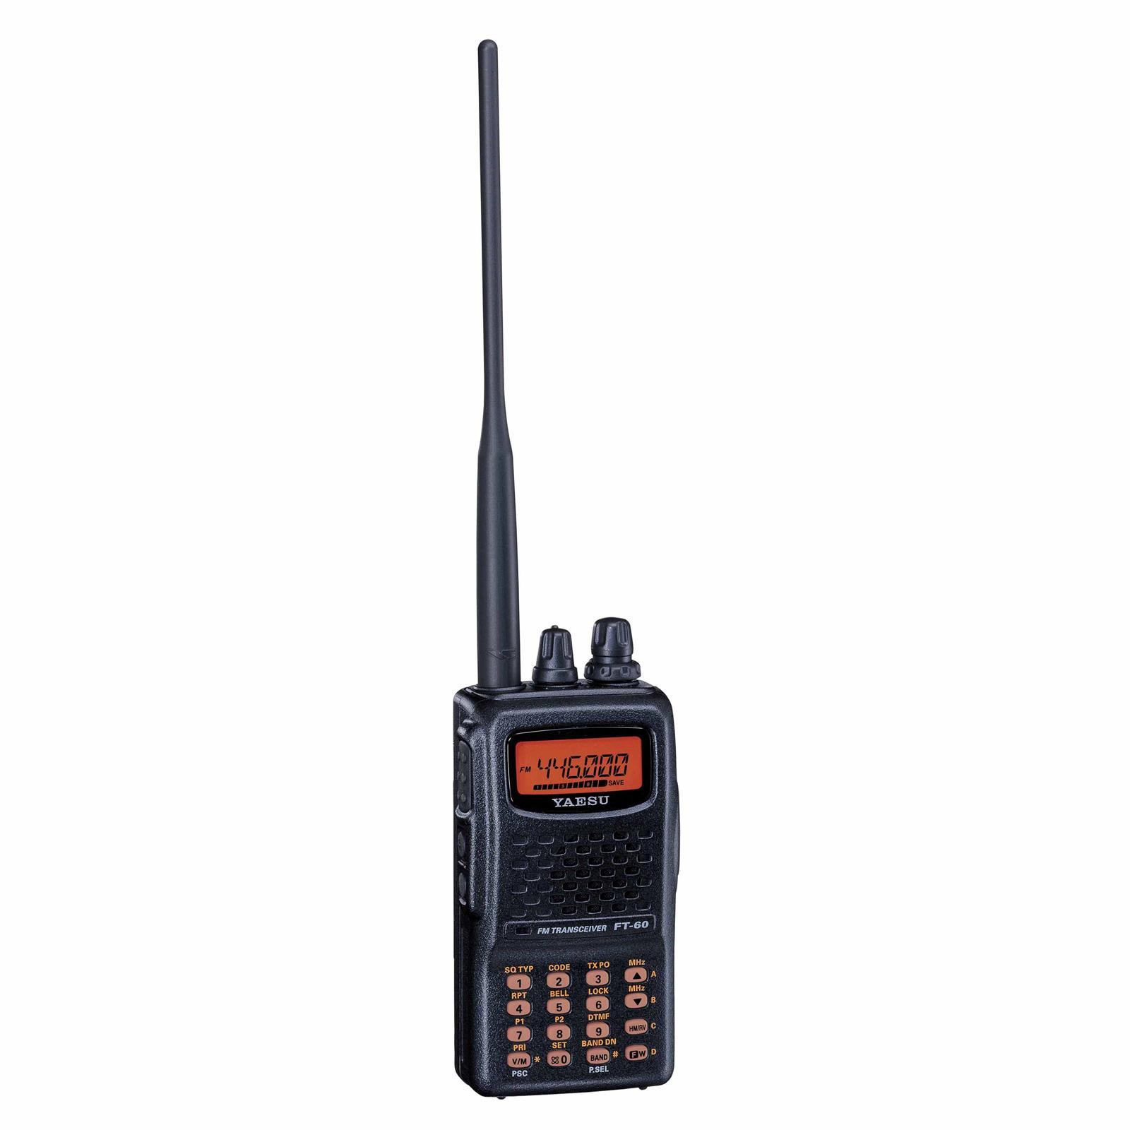
Program and Operation
Typical Modern Radio
Lots of Features
Lots of Buttons
Menus to work through
Small Display
Seldom Changed Features

Slide 10
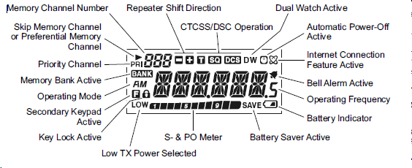

Slide 11
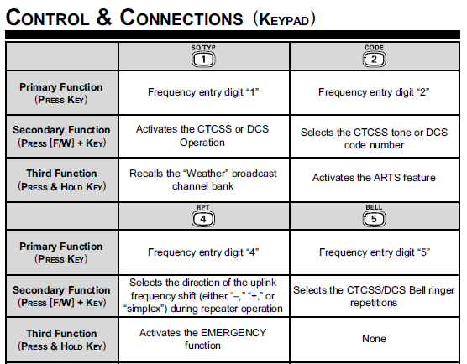

Slide 12
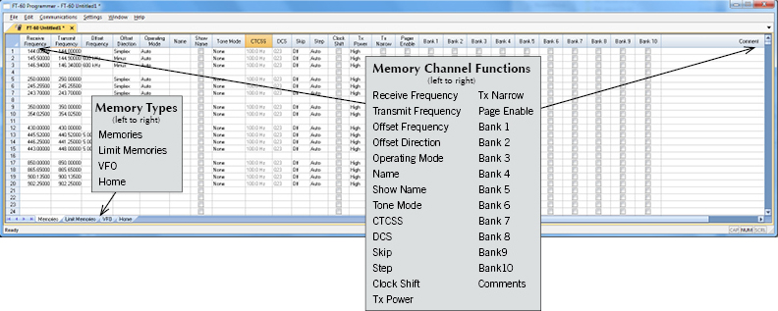
Program and Operation

Slide 13
Program and Operation
Rotator Control
Satellite Tracker
Complete Station Control

Slide 14
Add Radio control interface and many inputs become automatic!

Slide 15
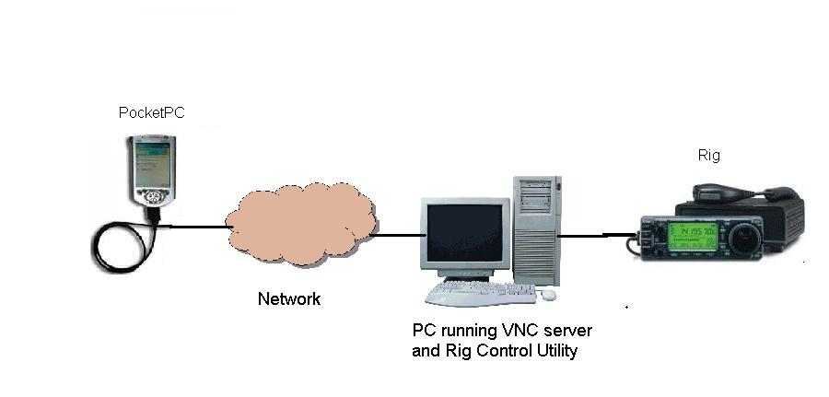
Ham radio over the internet

Slide 16
Digital Communications
Morse Code “The Original Digital Mode”
Hams now let the computer handle the translation from Analog to Digital and back.
More efficient than voice communications
Less power is required to make contact
Wide variety of “Modes” available

Slide 17
PACKET
OLIVIA
CONTESTIA
CW
HELL
RTTY
MFSK
PSK
MT63
DominoEX
THOR

Slide 18
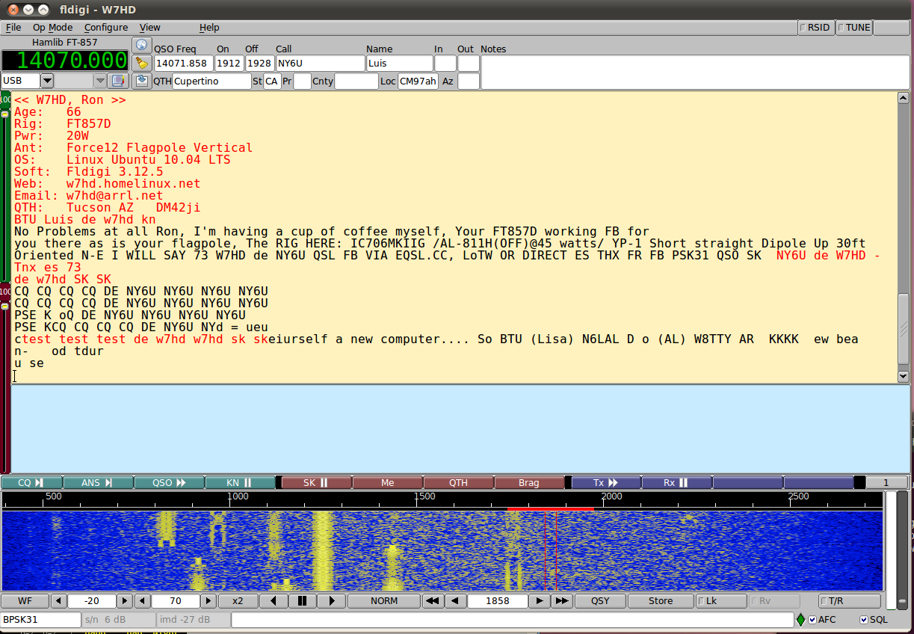

Slide 19
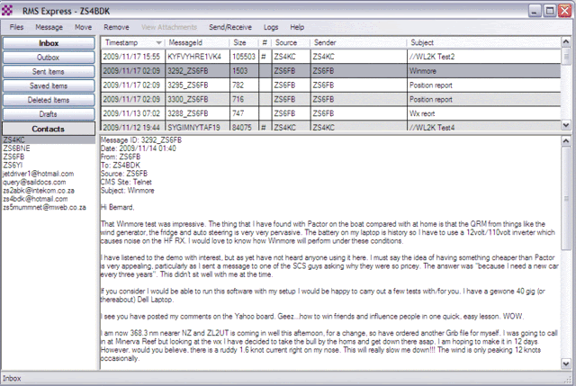

Slide 20
TYPICAL HF CONFIGURATION
INTERNET
COMPUTER
RADIO
Sound Card Interface

Slide 21
TYPICAL VHF / UHF CONFIGURATION
COMPUTER
RADIO
Terminal Node Controller

Slide 22
Digipeater Configuration
RADIO
Terminal Node Controller

Slide 23
Internet Gateway Configuration
INTERNET
COMPUTER
Windows, Raspberry PI, Arduino
RADIO
Terminal Node Controller

Slide 24
Software Defined Radio
Use the power of the computer to perform many of the mechanical functions of a typical radio. These include signal detection, signal processing and filtering.
Taylor the software to meet the particular situation and environment instead of managing with set capabilities.

Slide 25
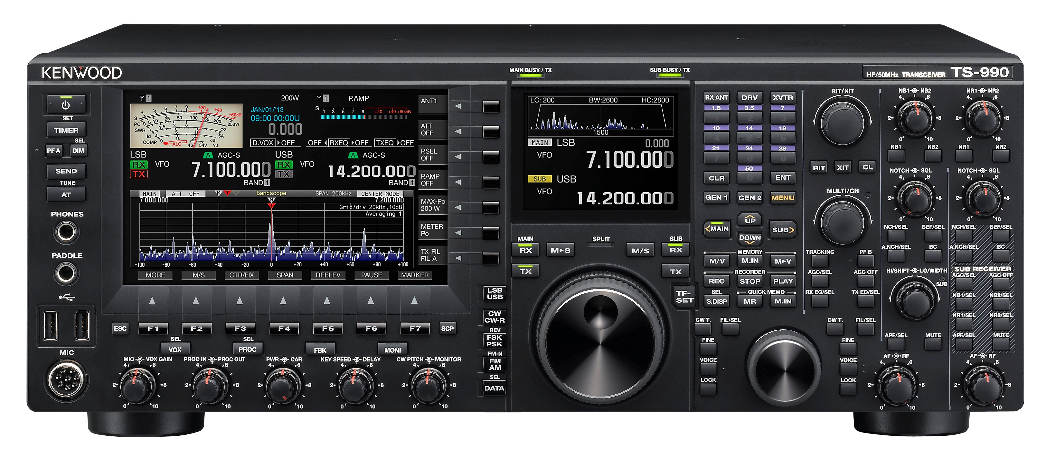
Current model ham radio transceiver
Kenwood TS-990

Slide 26
Software Defined radio

Slide 27
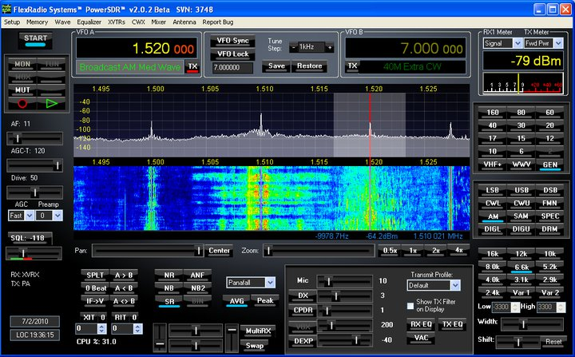

Slide 28
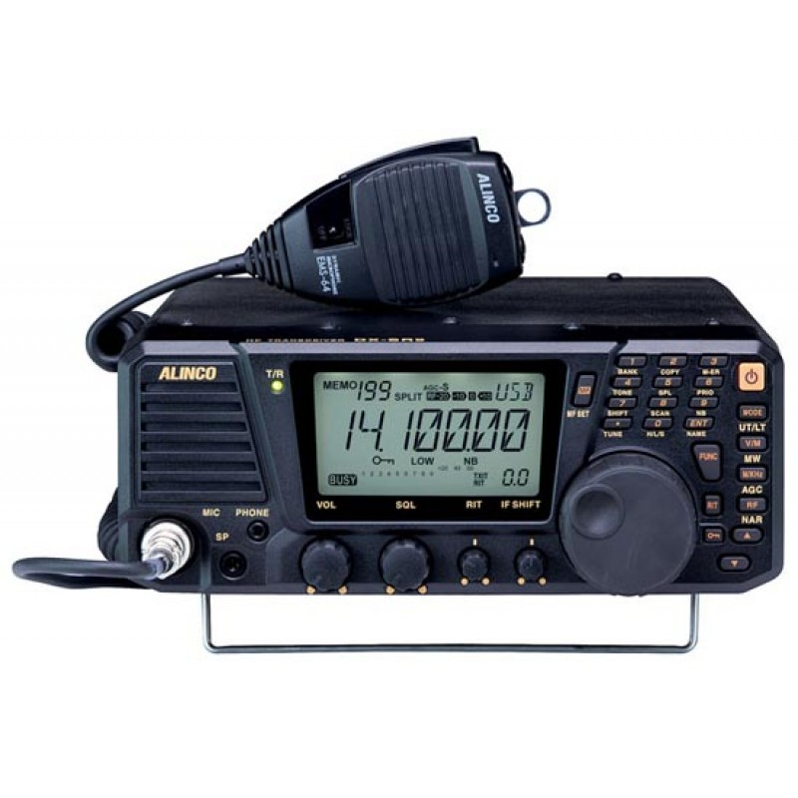
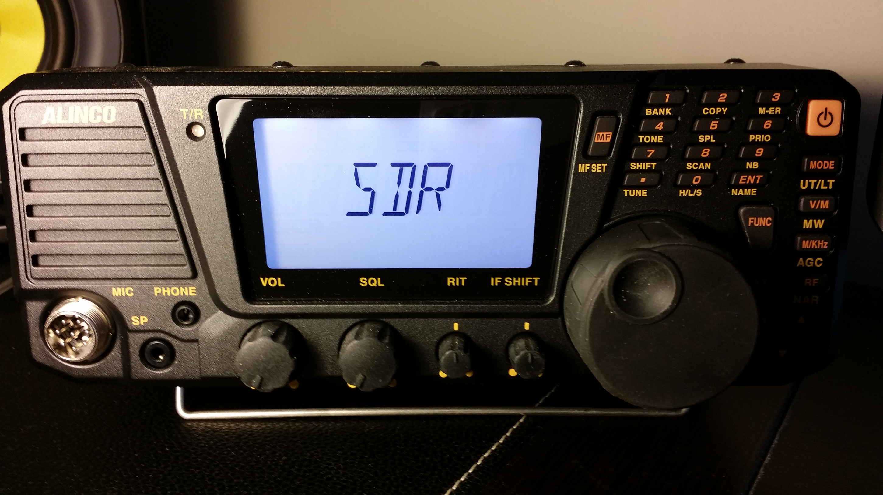
Hybrid Design Radio

Slide 29
Computers in Amateur Radio
Logging
Programming and Operation
Digital Communication
Software Defined Radio

Slide 30
Computers in amateur radio
Northville Amateur Radio Association
Candlewood Amateur Radio Association
American Radio Relay League
Connecticut Amateur Radio Emergency Service

Slide 31
Computers in amateur radio
Questions?

Slide 32
Computers in amateur radio
Thank You

